Slide 1
Jetpack Compose

Slide 2
Basics of Jetpack Compose
What is Jetpack Compose?
Overview and advantages over XML layouts.
Setting up Jetpack Compose in an Android project
Modifiers
Composable Functions
Basics of @Composable annotation.
Previewing Composables
Using @Preview annotation.

Slide 3
Contd..
What is Jetpack Compose?
A modern, fully declarative UI toolkit for building Android UIs.
Benefits:
No need for XML layouts.
Easier to manage dynamic UIs.
Improves code readability and reusability.
Compatible with existing View-based UI.

Slide 4
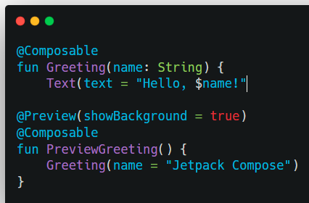
Composables and Preview

Slide 5
Layouts in Jetpack Compose
Column, Row, and Box
Arranging items vertically, horizontally, or overlapping.
Modifier
Using Modifier for padding, size, background, alignment, etc.
Lazy Components
LazyColumn, LazyRow for displaying lists efficiently.

Slide 6
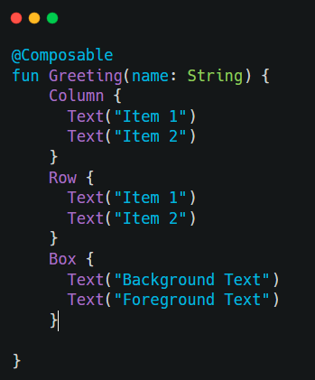
Column, Row, Box

Slide 7
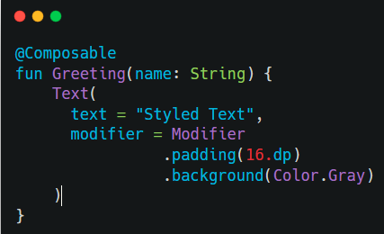
Modifiers

Slide 8
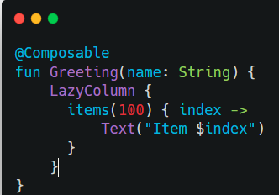
Lazy Components – LazyColumn and LazyRow

Slide 9
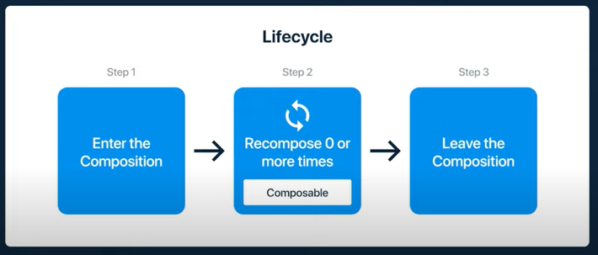
Recomposition
Whenever your state changes , it will recreate the UI.

Slide 10
Recomposition
Recomposition is the process where Jetpack Compose re-executes composable functions to update the UI when the state changes.
How Recomposition Works:
Trigger:
A change in State triggers recomposition.
Only the parts of the UI that depend on the changed state are recomposed.

Slide 11
Contd..
Optimized Rendering:
Compose skips recomposing parts of the UI that haven't changed.
Immutability:
Compose relies on the immutability of UI hierarchies during recomposition, meaning composables should produce the same result given the same inputs.

Slide 12
Remember API (remember)
What is remember?
remember is used to retain state across recompositions.
It helps store a mutable state inside a Composable function.
Without remember, every recomposition resets the state.

Slide 13
State and Lifecycle
State in Compose
Using remember, mutableStateOf, and rememberSaveable.
State Hoisting
Managing state between parent and child composables.
ViewModel Integration
Sharing state with the UI using viewModel.
Lifecycle Awareness
Handling lifecycle events in Compose.

Slide 14
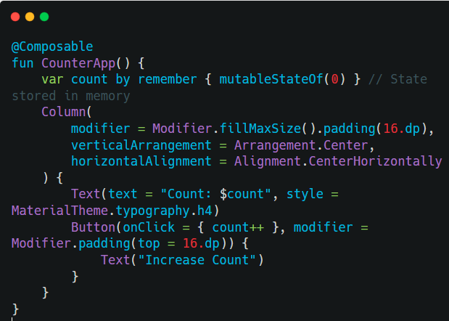
State in Compose
In Jetpack Compose, state determines the UI's behavior.
The UI automatically updates whenever the state changes.
The Compose framework observes this state, and when it changes, the UI is automatically updated to reflect the new state.

Slide 15
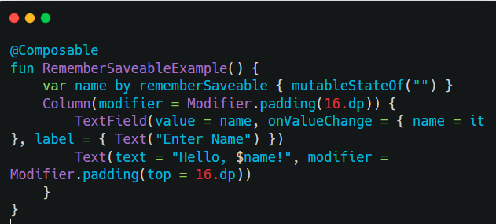
remember and rememberSaveable
remember: Keeps state across recompositions but not across process death or configuration changes.
rememberSaveable: Keeps state even after process death (e.g., orientation change).

Slide 16
rememberSaveable
In Jetpack Compose, rememberSaveable is an extension of remember that helps you manage state in a way that persists across configuration changes, such as screen rotations, process recreation, or navigating back to a composable.
It is particularly useful for states that represent user inputs or UI-related data that should survive such lifecycle events.

Slide 17
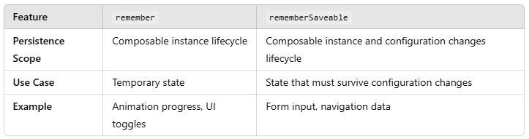
Remember vs rememberSaveable

Slide 18
State Hoisting
State hoisting is when you pass state and its updater function from a parent to child composable for better reusability and control.
State hoisting is one of the best practices in Jetpack Compose to ensure reusability, separation of concerns, and optimized UI recomposition. Use it when state needs to be shared between components or needs to be controlled from a higher level.

Slide 19
ViewModel
What is ViewModel?
A ViewModel is a lifecycle-aware component designed to store and manage UI-related data in a lifecycle-conscious way.
It survives configuration changes (like screen rotations) and allows separation of UI logic from UI components.
In Jetpack Compose, ViewModel is used to manage UI state efficiently and avoid unnecessary recompositions.

Slide 20
ViewModel
ViewModel with LiveData
If you're working with LiveData (e.g., in an MVVM architecture), you can integrate it with Jetpack Compose.
Observe LiveData in a Composable
To observe LiveData inside Compose, we use observeAsState().
ViewModel with Flow and StateFlow
Instead of LiveData, Jetpack Compose works well with Kotlin Flows and StateFlow.
Observe StateFlow in Compose
Use collectAsState() to collect StateFlow in Jetpack Compose.

Slide 21
Navigation
Jetpack Navigation with Compose
Navigating between screens using NavController.
Passing Data Between Screens
Deep Linking and Arguments

Slide 22
Key Concepts in Jetpack Compose Navigation
NavHost: The container for navigation. It defines the destinations (composables) and how they are navigated to.
NavController: This controls the navigation flow, allowing you to navigate between destinations and manage the back stack.
Navigation Routes: Each screen is identified by a route (a string), which allows navigation to that screen.
NavBackStackEntry: This represents the current destination in the navigation graph.
Arguments: You can pass data between destinations using arguments.

Slide 23
User Interaction
Handling User Input
Working with TextField and Button.
Gestures
Detecting taps, swipes, and drag gestures using
Modifier.pointerInput.
Dialogs, Menus, and Snackbars
Animations
Simple animations using animate*AsState.
Complex animations with Animatable and transitions.

Slide 24
Styling and Theming
Material Design Components
Using MaterialTheme and Material widgets like Button, Card, Scaffold, etc.
Custom Themes
Defining colors, typography, and shapes.

Slide 25
Examples
Dynamic Theme Toggle – Switching between light and dark mode.
Themed Buttons – Creating styled buttons with theme colors.
Typography Customization – Changing typefaces and sizes with MaterialTheme's typography.
Themed Cards with Styling – Using shapes, elevation, and MaterialTheme colors in a card.
Dynamic Theming with State – Applying changes dynamically based on UI state.

Slide 26
Animations
Types of Animations:
State-based Animations: Animating when state changes (e.g., size, position).
Transition Animations: Using AnimatedVisibility, Crossfade, etc., to transition between UI states.
Tween and Keyframes: Understanding tween animations and keyframe-based animations.
Physics-based Animations: Using spring and decay animations.

Slide 27
Contd..
Animation APIs:
animateFloatAsState(), animateDpAsState(), animateColorAsState(), etc.
AnimatedContent, animate*AsState for creating smooth transitions.
Modifiers and Animations: Modifier with animations for effects like scaling, rotation, and movement.

Slide 28
Interactions and Gestures
gestures like taps, drags, swipes, and other touch interactions are handled.
Gesture Detectors:
Modifier.pointerInput for detecting gestures.
detectTapGestures, detectDragGestures, detectTransformGestures for common gesture recognition.
Drag and Drop: Creating drag and drop functionality using Modifier.draggable.

Slide 29
Animations and Gestures
Animations with Gestures: Combine gestures with animations to create smooth transitions.
Handling Multi-touch Events: Detecting pinch, zoom, and multi-touch gestures.

Slide 30
Drag and Drop UI
Steps:
Create a draggable box using Modifier.draggable().
Use remember to store the drag state and position of the box.
Add boundary restrictions for the draggable box.
Change the color of the box when it’s being dragged.

Slide 31
Advanced Jetpack Compose Concepts
Custom Composables
Creating reusable composable components.
Compose Performance
Optimizing recomposition and UI rendering.
Interoperability
Combining XML-based views and Compose.
Testing in Compose
Unit testing Composables.
UI testing with Compose.

Slide 32
Working with APIs and Data
Networking in Compose
Using Retrofit or Ktor with Compose.
Displaying Live Data or Flow
Handling Asynchronous Data
Using Coroutines for user interactions.

Slide 33
Steps to create TODO App
Set up the project
Create a new Jetpack Compose project in Android Studio.
Set the theme and UI environment to use Jetpack Compose.
Create a UI for the to-do list
Design a simple screen with a TextField for adding tasks and a Button to submit them.
Display a list of tasks using LazyColumn().

Slide 34
Steps
Add state for tasks
Use mutableStateOf() to maintain a list of tasks.
Define a data class Task to store task names and their completion state.
Handle adding tasks
Implement logic to add tasks to the list when the user clicks the "Add" button.
Handle task completion

Slide 35
Steps
Create a checkbox or a button to mark tasks as completed.
Handle task deletion
Implement delete button for each task in the list.
Test the app
Test adding, completing, and deleting tasks while ensuring the UI updates correctly.

Slide 36
Steps for Stop Watch
Function Declaration
State Variables
time: Tracks the elapsed time in seconds.
Initialized to 0L (0 seconds).
Declared as a mutableStateOf so Compose can recompose the UI when its value changes.
isRunning: Tracks whether the stopwatch is currently running.
Initialized to false.
Also declared as a mutableStateOf for UI updates.

Slide 37
Steps for StopWatch
remember: Ensures the values persist across recompositions but reset when the composable leaves the composition.
Coroutine Scope

Slide 38
Steps for StopWatch
Column Layout
Column: Arranges child composables vertically.
modifier = Modifier.fillMaxSize(): Makes the column fill the entire screen.
horizontalAlignment = Alignment.CenterHorizontally: Centers children horizontally.
verticalArrangement = Arrangement.Center: Centers children vertically.

Slide 39
Steps for StopWatch
Elapsed Time Display
Displays the elapsed time in seconds (time) with "s" appended.
fontSize = 36.sp: Sets the text size to 36 scaled pixels.

Slide 40
Steps for StopWatch
Start Button
Button: A clickable UI element.
onClick: Lambda executed when the button is clicked.
Sets isRunning to true.
Launches a coroutine using scope.launch to increment time every second.
while (isRunning): Runs the loop as long as isRunning is true.
delay(1000): Pauses the coroutine for 1 second.
time++: Increments the elapsed time by 1.
Text("Start"): Sets the button's label.

Slide 41
Steps for StopWatch
Stop Button
Stops the timer by setting isRunning to false.
Text("Stop"): Sets the button's label.
Reset Button
Stops the timer and resets the elapsed time to 0.
isRunning = false: Stops the while loop if running.
time = 0: Resets the timer.
Text("Reset"): Sets the button's label.

Slide 42
Contd..
Steps:
Create a ball (circle) using Canvas.
Use animateDpAsState to animate the ball's vertical position.
Implement a bouncing effect by changing the ball's position based on state.
Modify the animation to use a spring for a more natural bounce effect.

Slide 43
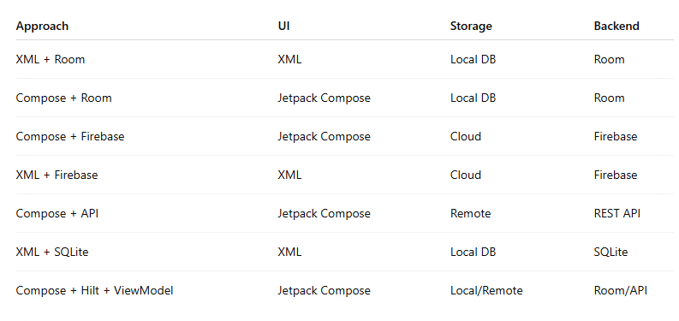
Registration in kotlin android

Slide 44
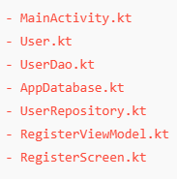
File Structure

Slide 45
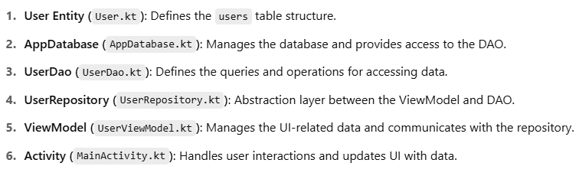

Slide 46
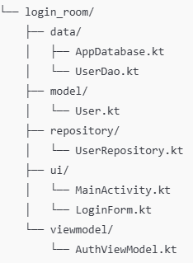
structure

Slide 47
